Slide 1




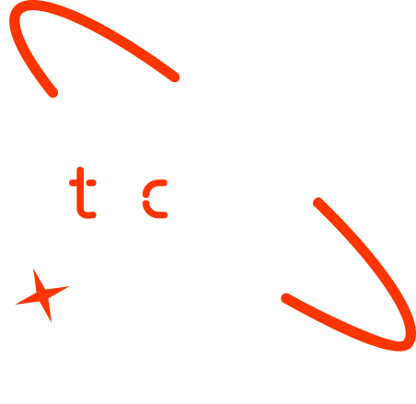

A new generation
of tech specialists

Slide 2
ConvTransNet: Enhancing Kidney Abnormality
Detection in CT Imaging
through Hybrid CNN-Transformer
Model with Integrated Explainability

Slide 3
Outline
Concept note and implementation plan:​
Background​
Objectives​
SDG Relation​
Data​
Data Collection​
Exploratory Data Analysis (EDA) and Feature Engineering​
Model Selection and Training​
Model Evaluation and Hyperparameter Tuning​
Model Refinement and Testing​
Results​
Deployment​
Future Work

Slide 4
Concept Note and Implementation

Slide 5
Background
The Kidney Classification System is a web-based application designed to classify kidney conditions using a hybrid CNN-Transformer Model.
Each year, kidney cancer affects over 430,000 people, leading to approximately 180,000 fatalities [1]. The incidence of kidney tumors surpasses this number, yet current radiographic techniques often cannot distinguish between malignant and benign tumors [2]
Addressing the increasing global incidence, reduce the healthcare workload , and provide an Enhanced Diagnosis and Management Systems.

Slide 6
Objectives
The primary aim of this project is to alleviate the workload of healthcare professionals by implementing an accurate classification system for kidney cases across four distinct clinical conditions (Cyst, Normal, Stone, Tumor).
Hybrid CNN-Transformer Model with Integrated Explainability has been exploited to achieve the goal.

Slide 7


SDG Relation

Slide 8
Data

Slide 9
Data Collection
The CT images were collected from the Picture Archiving and Communication System (PACS) of several hospitals in Dhaka, Bangladesh [3]
The dataset includes both contrast and non-contrast studies of the whole abdomen
DICOM studies containing confirmed diagnoses of kidney cysts, stones, normal findings, or tumors were carefully selected.
Batches of DICOM images have been created for each region of interest (ROI) associated with a specific radiological finding
Patient information and metadata were subsequently removed from the DICOM images before conversion to a lossless JPG format

Slide 10
Exploratory Data Analysis (EDA) and Feature Engineering
Key EDA processes applied include class distribution analysis, mask application, image statistics calculation, multiple image display, pixel value distribution investigation, and duplication checking.

Slide 11
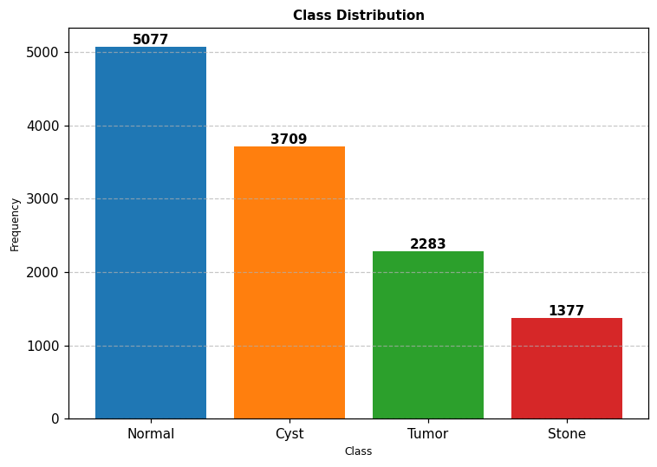
Exploratory Data Analysis (EDA) Class Distribution Analysis

Slide 12
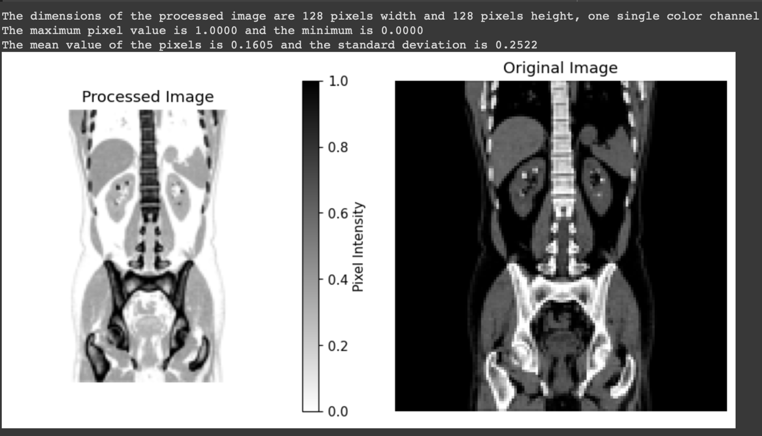
Exploratory Data Analysis (EDA) Mask Application

Slide 13
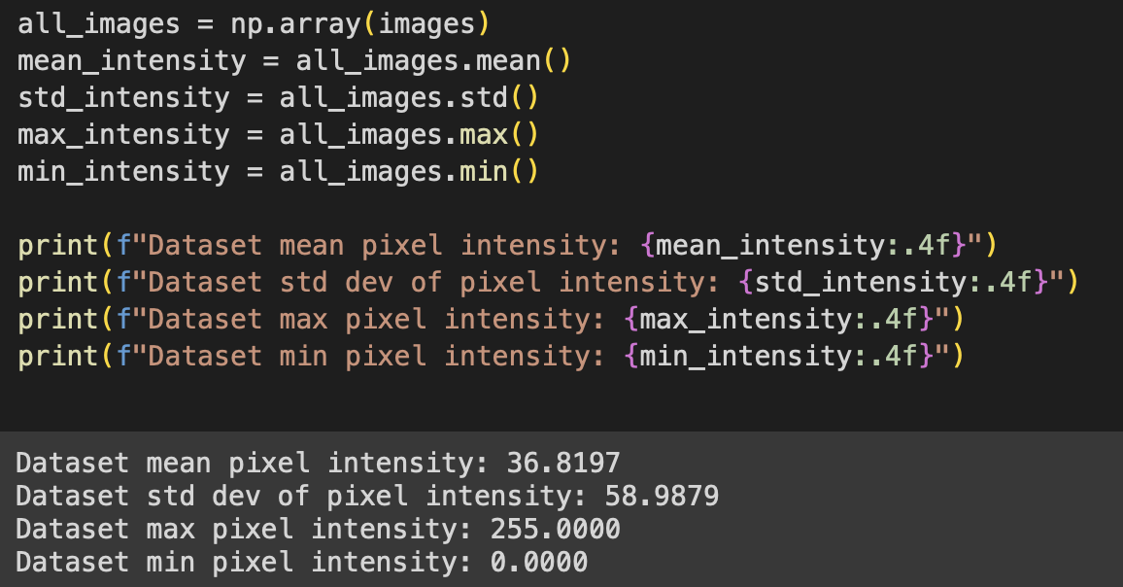
Exploratory Data Analysis (EDA) Image Statistics Calculation

Slide 14
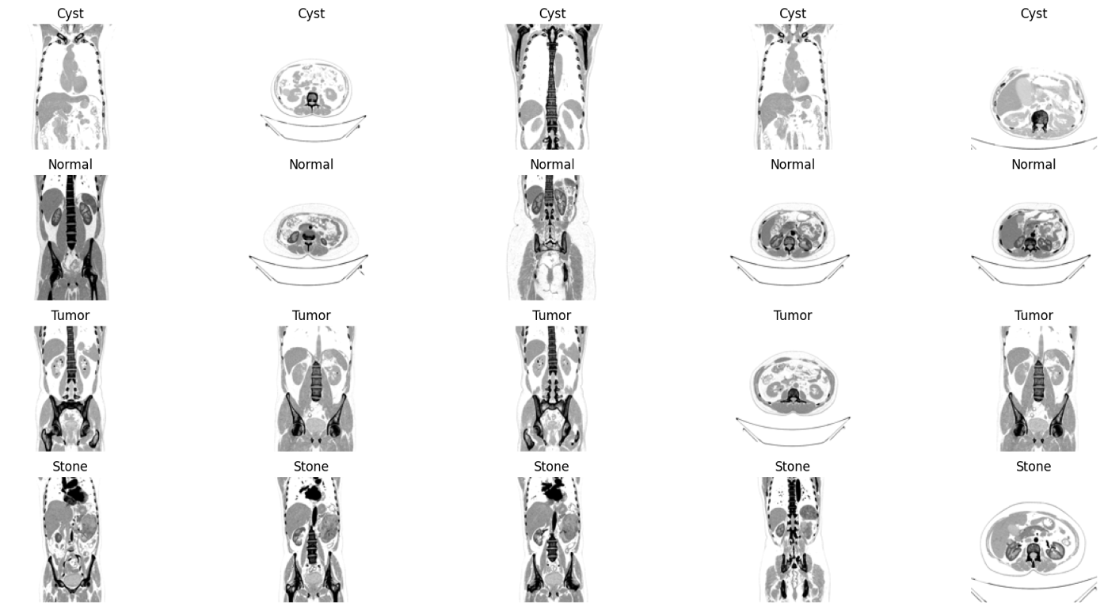
Exploratory Data Analysis (EDA) Multiple Image Display

Slide 15
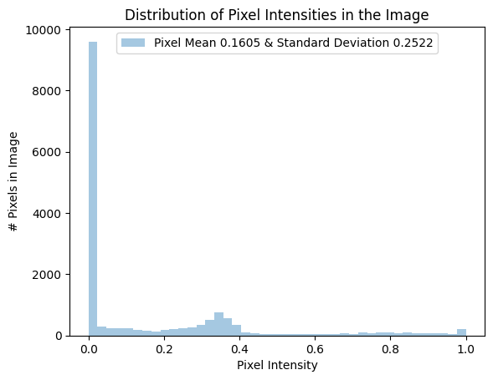
Exploratory Data Analysis (EDA) Pixel Value Distribution Investigation

Slide 16
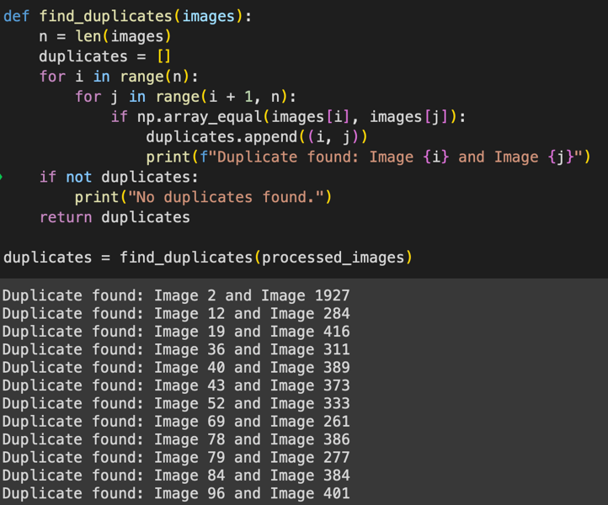
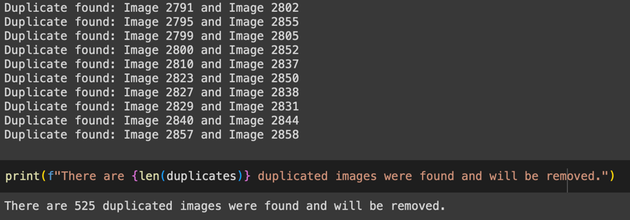
Exploratory Data Analysis (EDA) Duplication Checking

Slide 17
Exploratory Data Analysis (EDA) Data Balancing, Normalization & Augmentation
The Images have been normalized and their pixels values range between 0 and 1.
It worth to mention that all the images are resized to (128 x 128) instead of (366 x 366).
Label | Before Balancing | After Balancing | After Augmentation
Normal | 5,077 | 1,377 | 5,077
Cyst | 3,709 | 1,377 | 5,077
Tumor | 2,283 | 1,377 | 5,077
Stone | 1,377 | 1,377 | 5,077

Slide 18
Model

Slide 19
Model Selection and Training
The CNN's ability to extract various features and the Transformer's capability in sequence modeling to improve the detection of kidney abnormalities in CT scans.
Explainable AI (XAI) is then employed to further improve the model's interpretability by providing justifications for the classifications made
Using the transformer at the end of the model resulted in more difficulties to integrate XAI.

Slide 20
Model Evaluation and Hyperparameter Tuning
The hypermeter values used in training the model are shown on the table.
The evaluation metrics used to assess the model's performance. Include confusion matrices, Accuracy, Recall, Precision, F1-score, RMSE ,and MAE.
The initial evaluation of the model shows a 96.4% accuracy on the testing dataset
Hyperparameter | Value
Batch size | 128
Optimizer | RMSProp
Learning rate | 0.0001
Epochs | 50
Number of hidden layers | 4
Number of filters | 64
Kernal size | 2 x 2
Activation functions | ReLU – Softmax (output layer)

Slide 21
Model Evaluation and Hyperparameter Tuning
Performance Metrics
Confusion Matrix
Class | Precision | Recall | Specificity | F1 Score
Cyst | 0.9813 | 0.9747 | 0.9939 | 0.9780
Normal | 0.9607 | 0.9892 | 0.9870 | 0.9747
Stone | 0.9655 | 0.9310 | 0.9885 | 0.9479
Tumor | 0.9607 | 0.9709 | 0.9870 | 0.9658
Class | Cyst | Normal | Stone | Tumor
Cyst | 732 | 3 | 6 | 5
Normal | 3 | 734 | 4 | 1
Stone | 12 | 18 | 729 | 24
Tumor | 4 | 9 | 16 | 733

Slide 22
Model Refinement and Testing
In this stage the class distribution was adjusted to have balanced classes across the training, validation ,and testing datasets.
A CNN layer is added to improve explainability.
Grid search is employed to find the optimal hypermeters (Colab Pro).
Hyperparameter | Value
Batch size | 32
Optimizer | Adam
Learning rate | 0.001 (with decay )
Epochs | 20
Number of hidden layers | 7
Number of filters | 32, 64, 128 , 128, 256
Kernal size | 3 x 3
Activation functions | ReLU (hidden layers) – Softmax

Slide 23
Model Refinement and Testing
CT images training , validation ,and testing class distrbution
Label | Training Dataset | Validation Dataset | Testing Dataset
Normal | 3,554 | 761 | 762
Cyst | 3,554 | 761 | 762
Tumor | 3,554 | 761 | 762
Stone | 3,554 | 761 | 762

Slide 24
Result

Slide 25
Evaluation Results
The evaluation metrics used to assess the model's performance. Include confusion matrices, Accuracy, Recall, Precision, F1-score, RMSE ,and MAE.
After the refinement process are applied the model achieved impressive performance with F1-score of 100% , a RMSE (Root Mean Squared Error) score of 0.0049 and a MAE (Mean Absolute Error) of 0.00019.

Slide 26
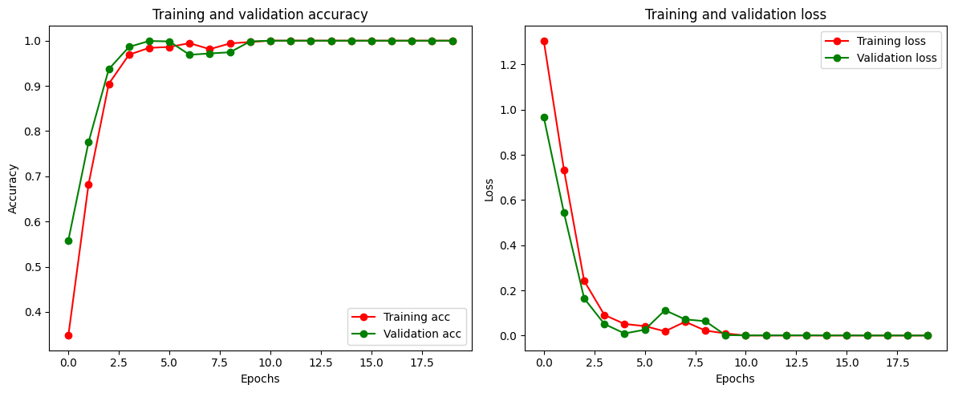
Evaluation Results
Losses and accuracies curves of training and validation datasets

Slide 27
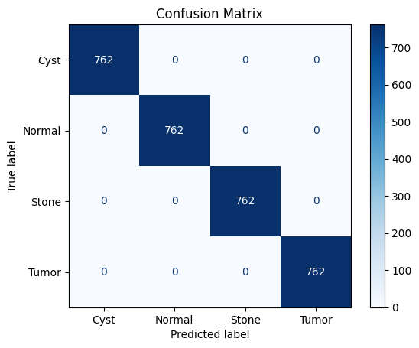
Evaluation Results
Class | Precision | Recall | F1-score | Samples
Tumor | 1.00 | 1.00 | 1.00 | 762
Normal | 1.00 | 1.00 | 1.00 | 762
Stone | 1.00 | 1.00 | 1.00 | 762
Cyst | 1.00 | 1.00 | 1.00 | 762
Accuracy |  |  | 1.00 | 3048
Performance Metrics of the Hybrid CNN-Transformer Model

Slide 28
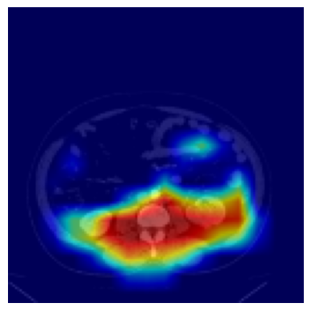
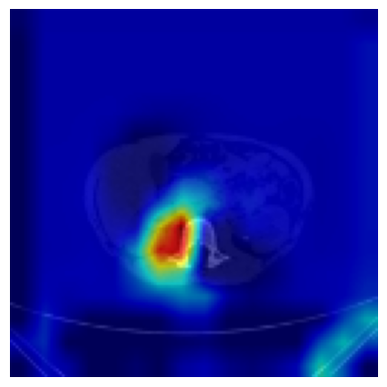
Evaluation Results
Tumor
Stone

Slide 29
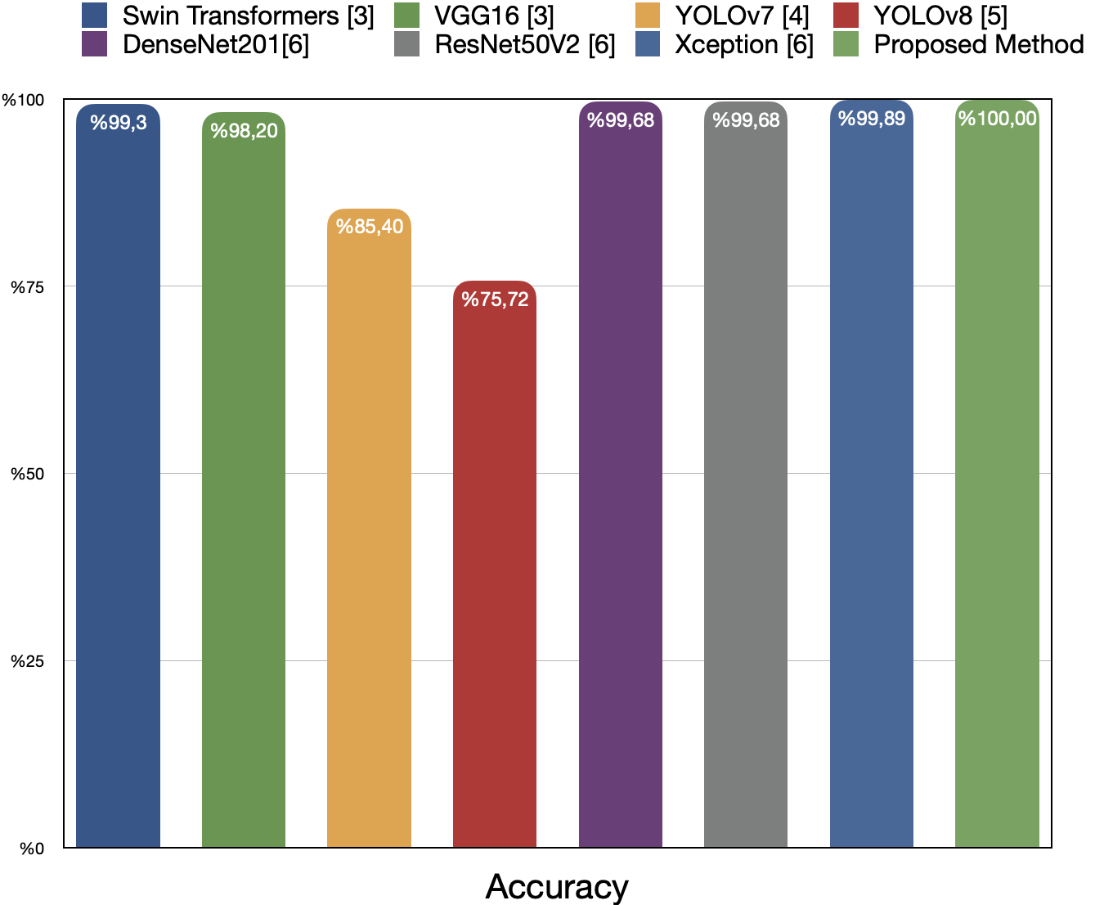
Literature Comparision
Model | Accuracy
Swin Transformers [3] | 99.30%
VGG16 [3] | 98.20%
YOLOv7 [4] | 85.40%
YOLOv8 [5] | 75.72%
DenseNet201[6] | 99.68%
ResNet50V2 [6] | 99.68%
Xception [6] | 99.89%
Proposed Method | 100%

Slide 30
Deployment

Slide 31
Deployment
Flask, HTML, and JavaScript are used to deploy a CNN-Trans model for classifying kidney CT images (Kidney Classification System)
Users can upload a CT image, which will be preprocessed in the backend before classification.
Upon pressing the "Predict Image" button, the model classifies the image into one of four conditions: “Normal,” “Cyst,” “Tumor,” or “Stone.”
The result is then displayed to the user.
Additionally, a heatmap is generated and displayed using the Grad-CAM algorithm to provide visual insights into the model's decision-making process.

Slide 32
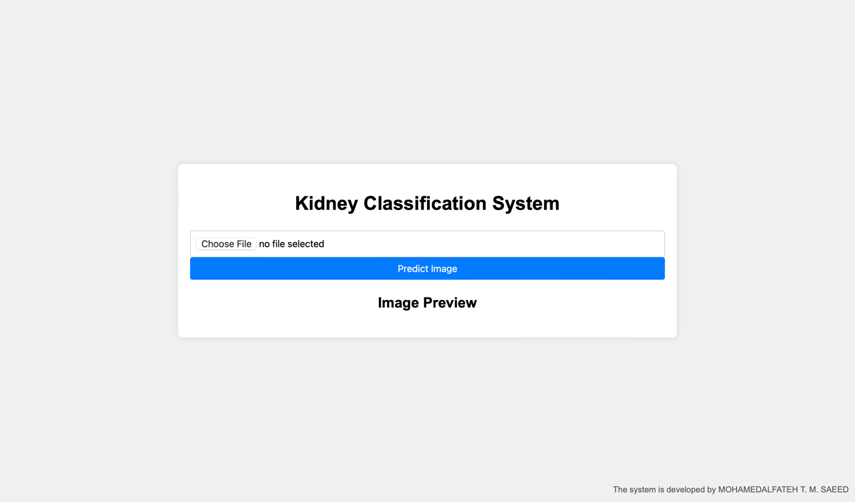
Deployment

Slide 33
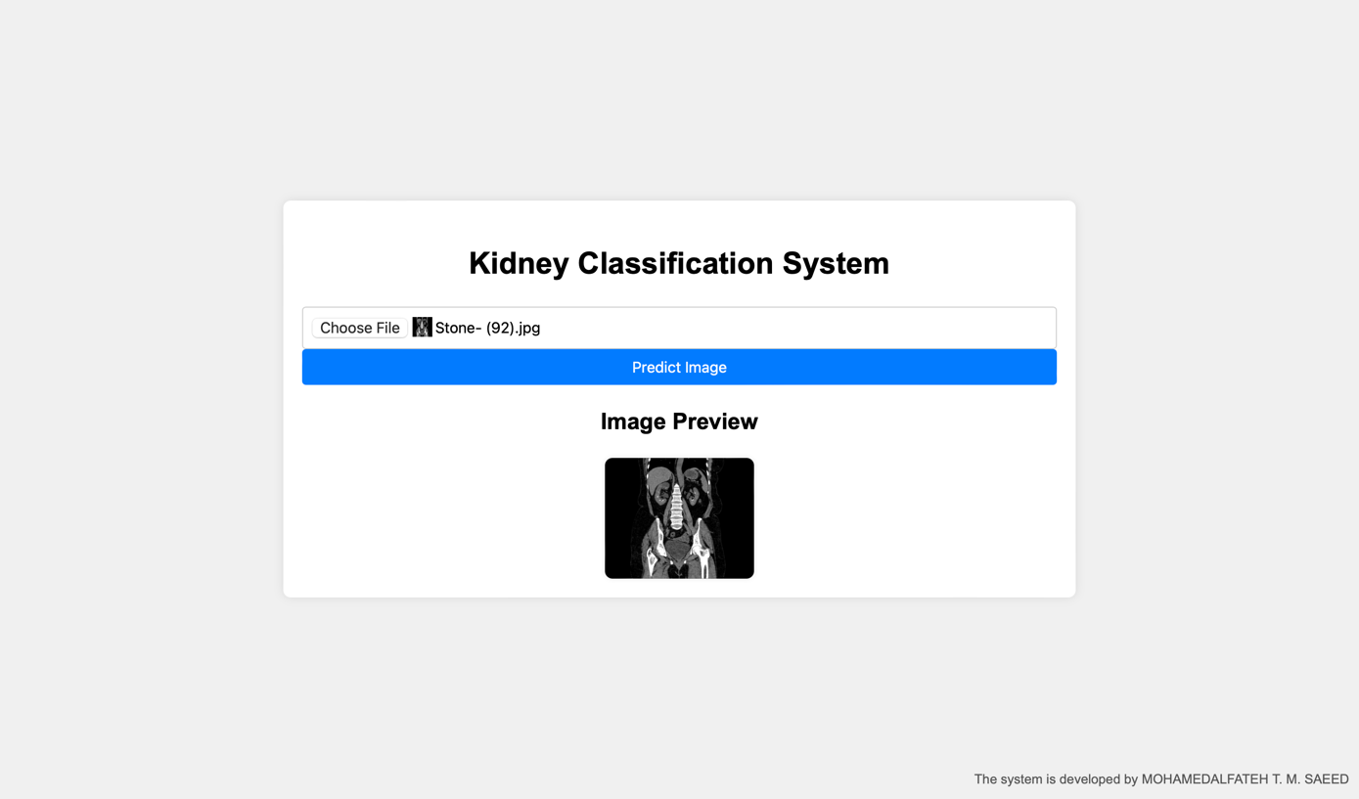
Deployment

Slide 34
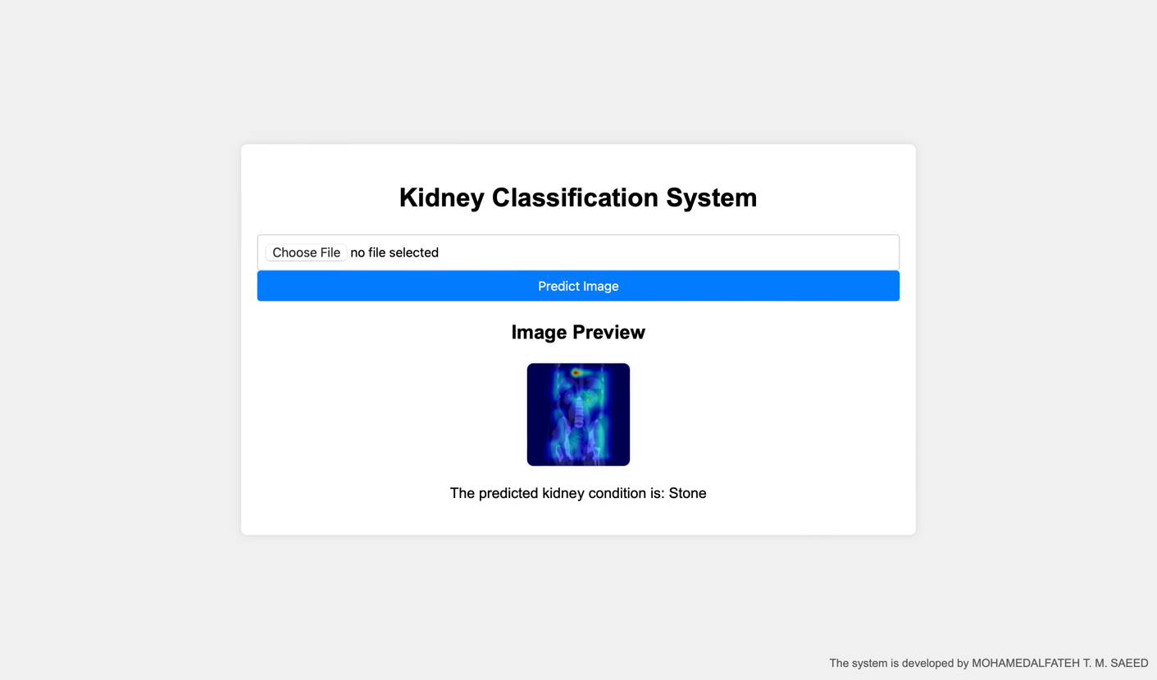
Deployment

Slide 35
Conclusion and Futurework
Integrating CNNs and transformers with explainable AI enhances medical imaging for detecting kidney abnormalities in CT scans. The CNN-Transformer model, combining local and global feature extraction, achieves 100% performance, surpassing existing methods.
Integrating socioeconomic and location features.
Improvement in XAI algorithm.
Can be used as Pre-trained Model for fine-tuning.

Slide 36
References
[1] | H. e. a. Sung, GLOBOCAN estimates of incidence and mortality worldwide for 36 cancers in 185 countries, : CA: a cancer journal for clinicians 71.3 209-249., 2020.
[2] | D. &. P. I. de Leon, Imaging and screening of kidney cancer, Radiologic Clinics, 55(6), 1235-1250, 2017.
[3] | M. N. H. M. H. M. K. A. M. G. R. U. M. Z. &. S. A. Islam, Vision transformer and explainable transfer learning models for auto detection of kidney cyst, stone and tumor from CT-radiography, vol. 12(1), Scientific Reports, 2022, pp. 1-14.
[4] | A. F. G. C. B. A. &. K. H. Bayram, A detection and prediction model based on deep learning assisted by explainable artificial intelligence for kidney diseases, vol. 40, Avrupa Bilim ve Teknoloji Dergisi, 2022, pp. 67-74.
[5] | S. D. &. A. R. Pande, Multi-class kidney abnormalities detecting novel system through computed tomography, IEEE Access, 2024.
[6] | Y. B. T. P. S. K. C. &. S. C. Kumar, A Comprehensive Study of Deep Learning Methods for Kidney Tumor, Cyst, and Stone Diagnostics and Detection Using CT Images, Archives of Computational Methods in Engineering, 2024, pp. 1-26.

Slide 37

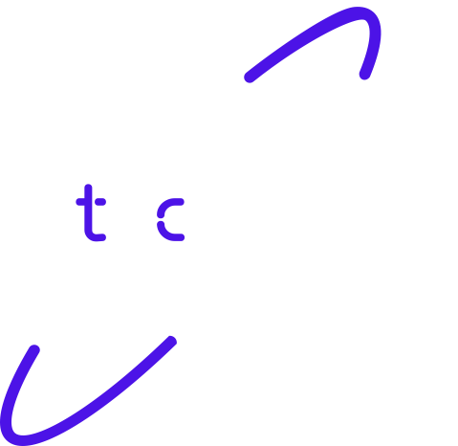
Thank you!

